Slide 1
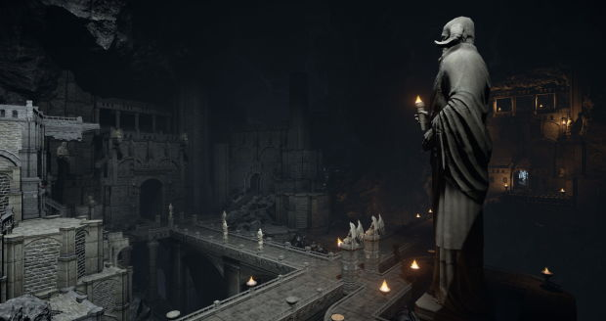
GAME PROGRAMMING
Week 4 — Level Design, Game Systems & Project Setup
LECTURES 7 & 8 | UNITY ENGINE | 2026

Slide 2
TABLE OF CONTENTS
TODAY'S AGENDA
01
LECTURE 7 — LEVEL DESIGN & GAME SYSTEMS
Core principles, spatial design, pacing, and Unity implementation
02
SCREENSHOTS & RESOURCES
Capture techniques, tools, and essential learning references
03
LECTURE 8 — CREATING A UNITY PROJECT
Unity Hub, templates, settings, and project organization
GAME PROGRAMMING — WEEK 4

Slide 3

01
LECTURE 7
LEVEL DESIGN & GAME SYSTEMS
Screenshots & Additional Resources

Slide 4
What is Level Design?
Level design is the art and science of creating interactive spaces that guide players through meaningful experiences. It combines spatial design, gameplay pacing, narrative delivery, and aesthetic composition.
A well-designed level teaches mechanics without explicit tutorials, builds emotional arcs through environmental storytelling, and maintains engagement through carefully calibrated challenge.
Level design sits at the intersection of game design, environmental art, and systems engineering — requiring both creative vision and technical implementation skills.
KEY DISCIPLINES
■ Spatial Design & Architecture
■ Gameplay Pacing & Flow
■ Environmental Storytelling
■ Visual Composition & Lighting
■ Systems Engineering
■ Player Psychology
"Every room is a question, every corridor is a hint, and every vista is a reward." — Level Design Philosophy
GAME PROGRAMMING — WEEK 4
04

Slide 5
Core Principles of Level Design
CLARITY
FLOW
AGENCY
FEEDBACK
Players must always understand their objective and available options. Use visual language, lighting, and spatial composition to guide attention naturally.
Maintain smooth player movement and progression. Eliminate frustrating bottlenecks while creating rhythmic alternation between tension and release.
Give players meaningful choices that affect their experience. Multiple paths, optional challenges, and emergent gameplay increase replayability.
Every player action should produce clear, immediate, and satisfying feedback through visual, audio, and haptic responses.
Remember: These four pillars work together. A level with perfect flow but no player agency feels like a movie. A level with great clarity but poor feedback feels hollow. Balance is key.
GAME PROGRAMMING — WEEK 4
05

Slide 6
Spatial Layout & Player Guidance
Effective spatial design uses environmental cues to guide players intuitively without breaking immersion:
Landmarking — Place distinctive visual markers that help players orient themselves and navigate complex spaces.
Funneling — Use architecture to naturally direct player attention toward objectives without feeling restrictive.
Weenies — Disney term for visible distant goals that draw players forward (like a castle on a hill).
Signposting — Use lighting, color contrast, and motion to highlight important elements.
THE GOLDEN PATH
Side Path
START
CHOICE
Main Path
GOAL
Design the optimal route while allowing exploration. Players should always see where they came from and where they're going.
GAME PROGRAMMING — WEEK 4
06

Slide 7
Pacing, Difficulty & Engagement Curves
Level pacing follows an emotional arc similar to storytelling — alternating challenge peaks with recovery valleys.
Difficulty Ramping
Introduce mechanics individually, then combine them in escalating complexity.
The Flow Channel
Balance challenge against skill; too easy = boredom, too hard = anxiety.
Breathing Room
Place safe zones after intense encounters for recovery and resource management.
Setpiece Moments — Design memorable high-intensity sequences as punctuation marks that players remember.
Playtesting is Essential — What designers find "challenging," players often find "impossible." Always test with fresh players.
GAME PROGRAMMING — WEEK 4
07

Slide 8
Level Design Practical Tips in Unity
1
Start with Greyboxing
PRO WORKFLOW TIPS
Block out spaces with primitive shapes before adding art. Iterate on layout fast without asset dependencies.
■ Lighting Early — Establish base lighting during greybox phase; lighting fundamentally changes how spaces feel.
■ Reference Volumes — Maintain a library of correctly-scaled reference objects to ensure proper proportions.
■ Test Constantly — Play your level after every significant change; what looks good in editor may play poorly.
2
Use ProBuilder
Unity's built-in tool for rapid prototyping of level geometry directly in the editor.
3
Prefab Everything
Turn repeating elements into prefabs for consistency and easy iteration across the project.
Golden Rule: A level that looks beautiful but plays poorly is a failed level. Always prioritize gameplay over aesthetics in early iterations.
GAME PROGRAMMING — WEEK 4
08

Slide 9

02
GAME SYSTEMS
ARCHITECTURE & PATTERNS
Component Design, Game Loop & Event Systems

Slide 10
Introduction to Game Systems
Game systems are the interconnected rules, mechanics, and subsystems that define how a game functions. They transform player input into meaningful output through structured logic.
INPUT SYSTEMS
PHYSICS SYSTEMS
RENDERING SYSTEMS
Capture and process player commands from keyboard, mouse, controller, or touch.
Simulate movement, collision detection, and environmental interaction.
Display visual output to the screen through cameras, shaders, and lighting.
AUDIO SYSTEMS
STATE MANAGEMENT
UI SYSTEMS
Manage sound effects, music, and spatial audio for immersive experiences.
Track game progress, save/load data, and manage scene transitions.
Present information and receive player interaction through interfaces.
AI Systems — Control non-player entity behavior and decision-making. Well-designed systems are modular, decoupled, and communicate through defined interfaces.
GAME PROGRAMMING — WEEK 4
10

Slide 11
Unity's Component-Based Architecture
Unity uses a component-based design where GameObjects are containers and Components define behavior:
GameObject — Empty container that exists in the scene.
Components — Modular modules: Transform, Renderer, Collider, scripts.
Composition > Inheritance — Combine components, avoid deep hierarchies.
COMPOSITION EXAMPLE
GameObject: Player
Transform | Sprite Renderer | Rigidbody2D | PlayerController
Saved as Prefab | Reusable Template
Prefabs — Reusable GameObject templates that maintain consistency across scenes. Edit the prefab, update all instances automatically.
ScriptableObjects — Data containers that live outside scene instances. Ideal for configuration data, shared game state, and event channels. Survive scene changes and don't require MonoBehaviour overhead.
GAME PROGRAMMING — WEEK 4
11

Slide 12
Design Patterns for Game Development
SINGLETON
OBSERVER / PUB-SUB
STATE MACHINE
Ensures only one instance of a class exists (GameManager, AudioManager). Provides global access point. Use sparingly to avoid tight coupling.
Decoupled event communication. Objects subscribe to events without direct references. Unity's C# events and UnityEvents implement this.
Manage entity behavior through discrete states (Idle, Walk, Attack) with defined transitions. Essential for AI and player controllers.
COMMAND PATTERN
OBJECT POOL
Encapsulate actions as objects to support undo/redo, action queuing, and replay systems. Each command becomes a self-contained object with Execute() and Undo() methods.
Reuse instantiated objects instead of repeated create/destroy cycles. Critical for performance with frequent spawning — bullets, particles, enemies. Prevents garbage collection stutter.
Tip: Don't force patterns where simple solutions work. The best architecture is the one your team can understand and maintain.
GAME PROGRAMMING — WEEK 4
12

Slide 13
The Game Loop & State Management
UNITY EXECUTION ORDER
Awake / Start
FixedUpdate (50Hz)
Update (frame)
LateUpdate
Rendering
OnDestroy
FixedUpdate runs at fixed timestep (default 0.02s = 50Hz) for physics. Update runs every frame for game logic. LateUpdate runs after all Updates — ideal for camera follow.
State Management Approaches
SCENE-BASED
SCRIPT-BASED
HYBRID
Use Unity scenes as state containers: Menu scene, Gameplay scene, GameOver scene.
Manage states in code with switch statements or dedicated state machine classes.
Combine scene loading with in-scene state transitions for complex games.
GAME PROGRAMMING — WEEK 4
13

Slide 14
Event-Driven Communication
Modern Unity games rely on event-driven architecture for loose coupling between systems. Three primary approaches:
C# EVENTS / DELEGATES
UNITYEVENTS
SCRIPTABLEOBJECT EVENTS
Native .NET event system built into C#. Good for intra-system communication within the same assembly.
Pros: Fast, type-safe, no external dependencies
Cons: Not serializable, tight compile-time coupling
Serializable in the Inspector. Designers can wire events without modifying code.
Pros: Designer-friendly, visual wiring, no code needed
Cons: Slower than C# events, harder to debug
Scriptable Objects as event channels enable cross-scene communication without direct references.
Pros: Fully decoupled, cross-scene, testable
Cons: More setup, potential for memory leaks
Best Practices: Unsubscribe from all events in OnDestroy() to prevent memory leaks. Use strongly-typed event payloads. Keep event handlers lightweight — defer heavy processing. Document your event schema so team members understand available channels.
GAME PROGRAMMING — WEEK 4
14

Slide 15
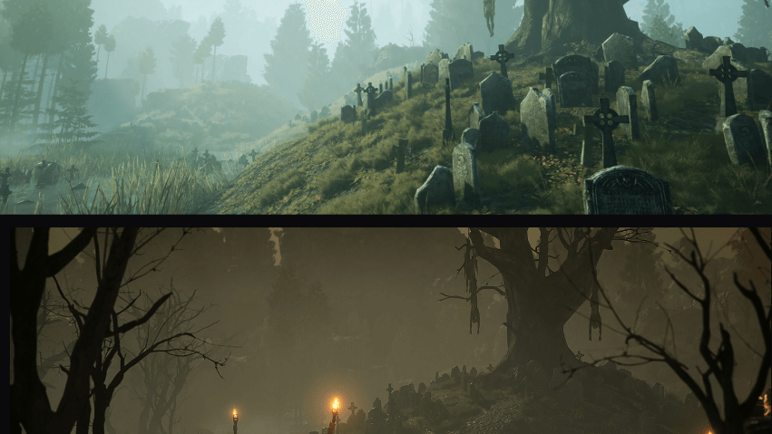
03
SCREENSHOTS
CAPTURE & TOOLS
Techniques, Advanced Methods & Unity Recorder

Slide 16
Screenshot Methods Overview
Capturing images from your game serves multiple purposes: debugging, marketing materials, player features, and portfolio documentation.
SCREENCAPTURE API
RENDERTEXTURE
UNITY RECORDER
Built-in static method for basic screenshot capture. One line of code saves the full game view as PNG.
Best for: Quick debug captures, simple save functionality
Advanced technique for camera-specific screenshots with layer filtering and transparent backgrounds.
Best for: In-game photo modes, UI exclusion
Professional-grade capture tool for high-quality screenshots and video recording with full configuration.
Best for: Marketing trailers, portfolio footage
Choosing the right tool depends on your quality requirements, performance constraints, and whether you need to exclude UI elements or capture from specific cameras.
GAME PROGRAMMING — WEEK 4
16

Slide 17
Using ScreenCapture.CaptureScreenshot
The simplest built-in method for taking screenshots:
Basic usage: Call ScreenCapture.CaptureScreenshot("filename.png") to save a PNG.
Supersampling: The superSize parameter multiplies resolution — pass 4 for 4x quality.
Coroutine pattern: Use WaitForEndOfFrame() to ensure complete rendering.
File locations: Editor saves to project root; builds save to persistentDataPath.
EXAMPLE CODE
public KeyCode shotKey = KeyCode.F12;
void Update() {
if (Input.GetKeyDown(shotKey))
StartCoroutine(TakeShot());
}
IEnumerator TakeShot() {
yield return new WaitForEndOfFrame();
ScreenCapture.CaptureScreenshot(
"shot.png", 2);
}
IMPORTANT NOTES
Screenshots include the full game view including UI. Overwrites existing files. On mobile, files save to Application.persistentDataPath. Use full path: System.IO.Path.Combine(Application.persistentDataPath, "shot.png")
GAME PROGRAMMING — WEEK 4
17

Slide 18
Advanced Screenshot Techniques
For camera-specific captures with layer control, use the RenderTexture approach:
RENDERTEXTURE METHOD STEPS
KEY CAPABILITIES
1. Create a RenderTexture with target resolution
2. Assign it to the target camera's targetTexture
3. Call camera.Render() to render the frame
4. Read pixels into a Texture2D using ReadPixels()
5. Encode to PNG/JPG and write to file
6. Clean up RenderTexture to free GPU memory
■ Exclude UI by setting camera culling mask
■ Capture with transparent backgrounds
■ Take screenshots from hidden cameras
■ Custom resolutions and aspect ratios
USE CASES
In-game photo modes, inventory item rendering, procedural thumbnail generation, character portrait capture
Performance Note: Creating RenderTextures is GPU-intensive. Pool and reuse them when taking frequent captures to avoid frame drops.
GAME PROGRAMMING — WEEK 4
18

Slide 19
Unity Recorder for Professional Capture
Installation: Open Package Manager → Install "Unity Recorder" → Access via Window > General > Recorder
IMAGE SEQUENCE
MOVIE RECORDER
Capture single or multiple frames as PNG, JPG, or EXR.
■ Single Frame mode for precise screenshot timing
■ Multi-frame capture for animation sequences
■ F10 shortcut for quick capture
Record gameplay video in multiple formats.
■ MP4, WebM, or ProRes output formats
■ Configurable resolution and frame rate
■ Source: Game View, Targeted Camera, Render Texture
KEY FEATURES & BEST USES
Best for: Marketing trailers, bug reproduction videos, portfolio footage, and automated capture pipelines.
Output location: Files save to the project's Recordings folder by default. Change in recorder settings.
GAME PROGRAMMING — WEEK 4
19

Slide 20
Additional Resources & References
OFFICIAL RESOURCES
COMMUNITY & CODE
■ Unity Documentation — docs.unity3d.com
Comprehensive API reference and manuals
■ Unity Learn — learn.unity.com
Structured courses, projects, certifications
■ Unity Asset Store — assetstore.unity.com
Pre-built assets, tools, editor extensions
■ Unity Forums — forum.unity.com
Community support and Showcase
■ r/Unity3D — Reddit community
Quick questions, feedback, inspiration
■ GitHub Unity — github.com/Unity-Technologies
Official ECS samples and open-source tools
RECOMMENDED BOOKS
■ "Game Programming Patterns" by Robert Nystrom (free online) ■ "Unity in Action" by Joe Hocking ■ "Level Design" by Christopher Totten
GAME PROGRAMMING — WEEK 4
20

Slide 21
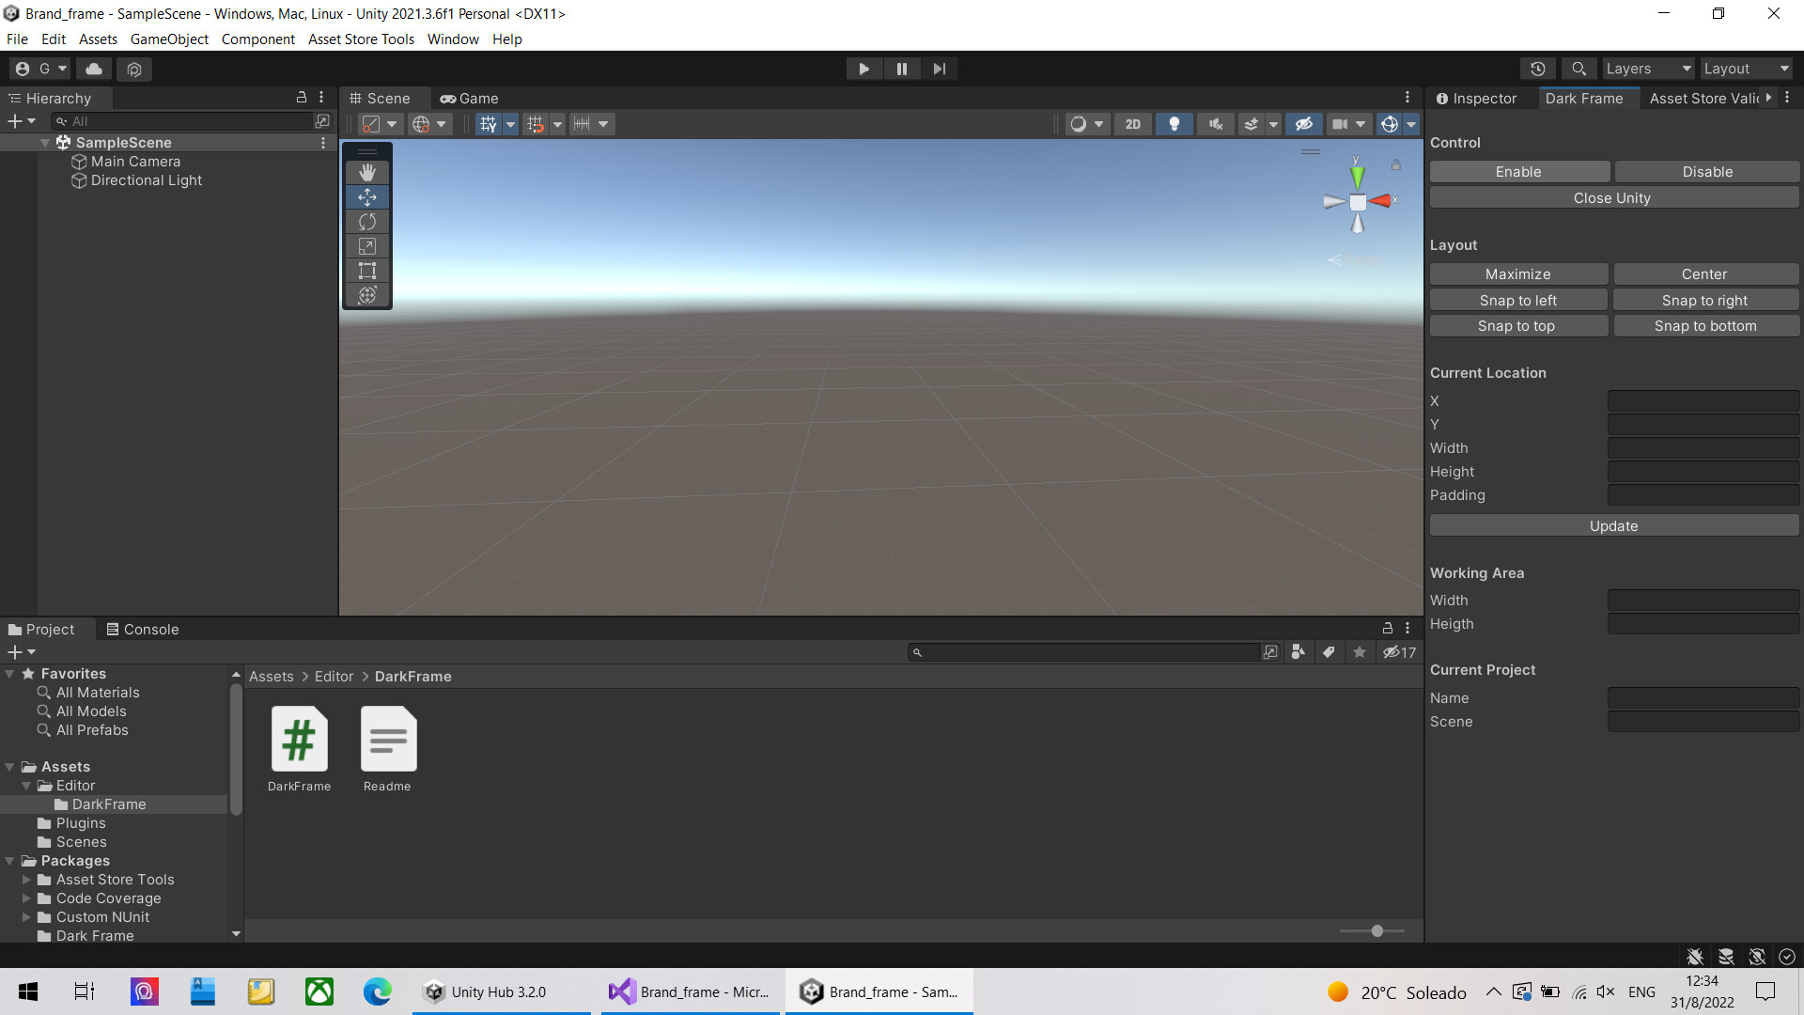
04
LECTURE 8
CREATING A UNITY PROJECT
Hub, Templates, Settings & Organization

Slide 22
Getting Started with Unity Hub
Unity Hub is your central command center for managing projects, editors, and licenses.
INSTALLING EDITORS
PROJECT MANAGEMENT
Hub > Installs > Install Editor. Choose LTS for stability; Tech Stream for latest features.
View all projects with Unity version, last modified date, and target platform.
CREATING PROJECTS
LICENSE MANAGEMENT
Click "New Project" to begin the creation wizard with template selection.
Manage Plus/Pro/Personal license activation from the Hub interface.
Tip: Always use the latest LTS version for coursework to ensure stability and community support. LTS releases receive bug fixes for 2+ years.
GAME PROGRAMMING — WEEK 4
22

Slide 23
Understanding Project Templates
Unity provides pre-configured templates that set up the render pipeline, packages, and folder structure.
Template | Description | Best For
3D (Built-in) | Legacy Built-in Render Pipeline. Limited modern features. | Learning fundamentals, older tutorials
3D (URP) | Universal Render Pipeline with modern visual features | Most projects — Recommended
2D (URP) | URP configured for 2D with 2D renderer and lighting | 2D games, platformers, top-down games
2D (Built-in) | Legacy 2D template using Built-in Render Pipeline | Older 2D projects, specific asset compatibility
Template selection impacts: available visual effects, performance characteristics, and platform compatibility. Choosing correctly at project creation avoids painful render pipeline migrations later.
GAME PROGRAMMING — WEEK 4
23

Slide 24
URP vs Built-in Render Pipeline
RECOMMENDED
LEGACY
UNIVERSAL RENDER PIPELINE
BUILT-IN RENDER PIPELINE
■ Optimized for performance across all platforms
■ Modern rendering: Shader Graph, VFX Graph
■ 2D lights and post-processing stack
■ Forward rendering with Forward+ option
■ Unity's officially supported pipeline
■ Scales from mobile to high-end PC/console
■ Legacy system, no longer actively developed
■ Most third-party asset compatibility
■ Older tutorials reference this pipeline
■ Higher overhead on mobile and VR
■ Still functional for existing projects
■ Not recommended for new projects
Recommendation: Choose URP for all new projects unless you specifically need a Built-in-only asset. URP is Unity's officially supported forward-looking pipeline.
GAME PROGRAMMING — WEEK 4
24

Slide 25
Project Settings & Configuration
After creating your project, configure these essential settings via Edit > Project Settings:
PLAYER
QUALITY
GRAPHICS
Company name, product name, bundle ID, resolution, splash screen
Presets (Low/High/Ultra) controlling shadows, anti-aliasing, textures
Render pipeline asset, tier settings, built-in shader variants
INPUT SYSTEM
TAGS AND LAYERS
PHYSICS & TIME
Choose legacy Input Manager or new Input System package
Define custom tags and layer masks for collision and culling
Gravity, fixed timestep (default 0.02s = 50Hz), layer collision matrix
Audio Settings: Configure default sample rate, DSP buffer size, and virtual voice count. Time Settings: Fixed timestep controls physics update rate — lower values = more accurate but more CPU usage.
GAME PROGRAMMING — WEEK 4
25

Slide 26
Project Structure & Organization
RECOMMENDED FOLDER HIERARCHY
Naming Conventions
■ Use PascalCase for folders and files
■ Prefix scenes: 00_MainMenu, 01_Level1
■ Group related assets in subfolders
■ Avoid spaces; use underscores or PascalCase
Assets/
_Project/
Animations/
Audio/ (Music/, SFX/)
Materials/
Models/
Prefabs/ (Environment/, UI/)
Scenes/ (Development/, Production/)
Scripts/ (Managers/, Systems/, UI/)
ScriptableObjects/
Shaders/
Sprites/
Textures/
VERSION CONTROL SETUP
■ Initialize Git repository at project root
■ Add .gitignore for Unity (Library/, Temp/, obj/)
■ Use Git LFS for large binaries (textures, models)
■ Commit after setup and before major changes
GAME PROGRAMMING — WEEK 4
26

Slide 27
Best Practices & Development Workflow
1
USE PREFABS
2
SCENE ORGANIZATION
3
VERSION CONTROL
Everything reusable should be a Prefab. Changes propagate automatically to all instances.
Use empty GameObjects as folders ("--- ENVIRONMENT ---") to keep Hierarchy clean.
Commit frequently with descriptive messages. Create feature branches for experimental work.
4
NAMING STANDARDS
5
PERFORMANCE AWARENESS
6
REGULAR BUILDS
Consistent naming across scenes, scripts, and assets. Avoid spaces in file names.
Enable Stats overlay to monitor draw calls, triangles, and memory from day one.
Test on your target platform early and often. Editor performance differs from builds.
Documentation: Maintain a README.md in your repository explaining project setup, controls, and architecture decisions. Future you will thank present you.
GAME PROGRAMMING — WEEK 4
27

Slide 28
WEEK 4 COMPLETE
KEY TAKEAWAYS
■ Level design creates player experiences through spatial storytelling
■ Game systems architecture enables scalable, maintainable code
■ Screenshots capture your work for debugging and showcasing
■ A well-configured Unity project is the foundation of success
■ Choose URP for new projects; organize with discipline
■ Version control and documentation are non-negotiable
Next Week: Scripting fundamentals, player controllers, and physics

